Slide 1


Sponsored Programs Administration Resource & Knowledge Series
GETTING STARTED
Presented by:
Svetlana Shtrom, Terri Vallery,
Betsy Gray, Douglas Backman

Slide 2
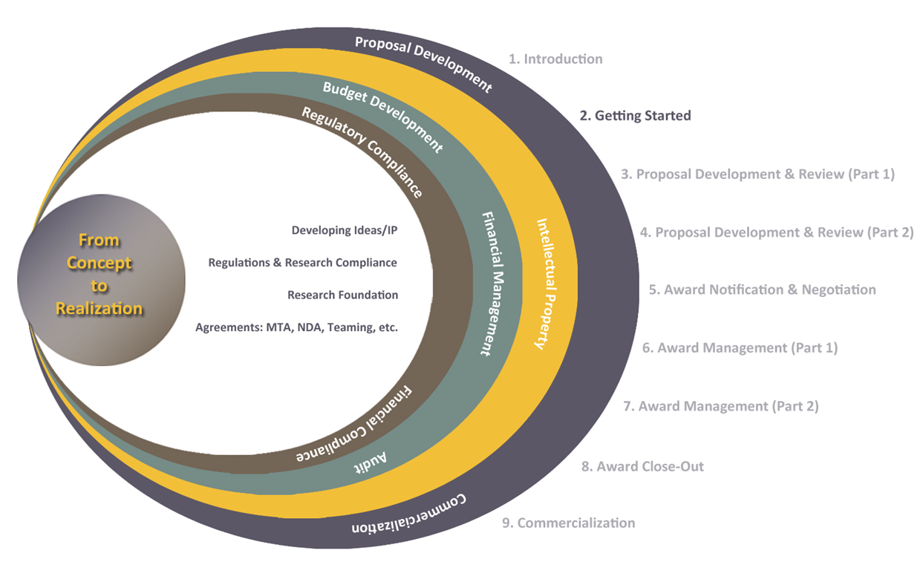
Exploring Research Administration from Concept to Commercialization

Slide 3
Exploring Research Administration from Concept to Commercialization
DEVELOPING IDEAS
Svetlana Shtrom, Ph.D., MBA

Slide 4
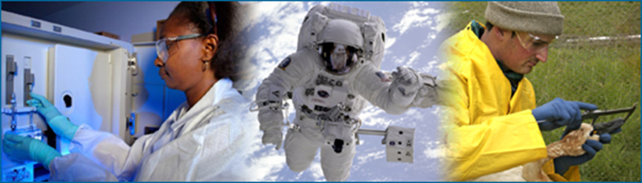
SOURCES OF IDEAS
Research results
Gradual advancement of on-going research
Screens for new pathways or biomarkers
Unexpected findings
Scientific publications / conferences
Significant new findings in the field
Discoveries from other fields applied to current field
Collaboration
Intramural
Extramural
Serendipity
Any time; anywhere
Source: http://undsci.berkeley.edu/index.php
GETTING STARTED

Slide 5

SOURCES OF IDEAS: RESEARCH
Research results
Gradual advancement of on-going research
Screens for new pathways or biomarkers
Unexpected findings
Source: http://undsci.berkeley.edu/index.php
GETTING STARTED

Slide 6
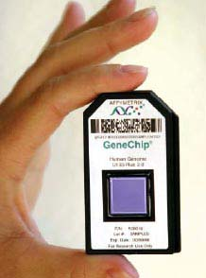
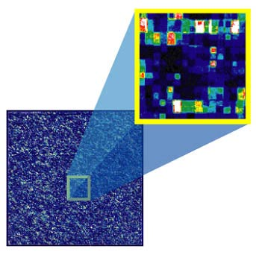
SOURCES OF IDEAS: RESEARCH
Research results
Gradual advancement of on-going research
Screens for new pathways or biomarkers
Unexpected findings
Source: Affymetrix
GETTING STARTED

Slide 7

SOURCES OF IDEAS: PUBLICATIONS
Scientific publications / conferences
Significant new findings in the field
Discoveries from other fields applied to current field
Self-organizing optic-cup morphogenesis in three-dimensional culture
Source: http://www.nature.com/nature/current_issue.html
GETTING STARTED

Slide 8
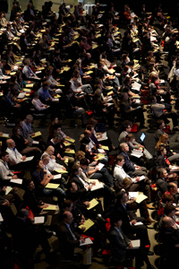

SOURCES OF IDEAS: CONFERENCES
Scientific publications / conferences
Significant new findings in the field
Discoveries from other fields applied to current field
Source: American Association for Cancer Research
GETTING STARTED

Slide 9
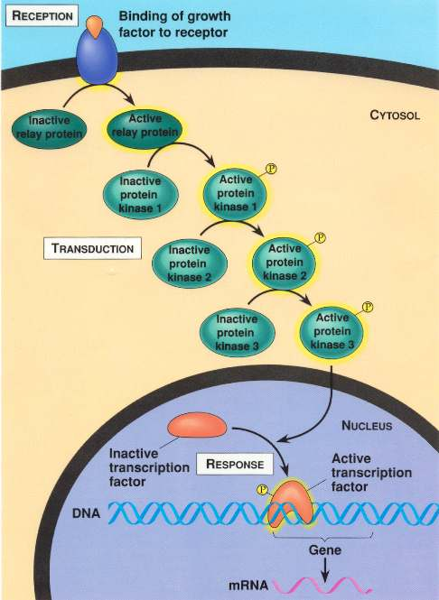
SOURCES OF IDEAS: COLLABORATION
Collaboration
Intramural
Extramural
Source: http://www.uic.edu
GETTING STARTED

Slide 10
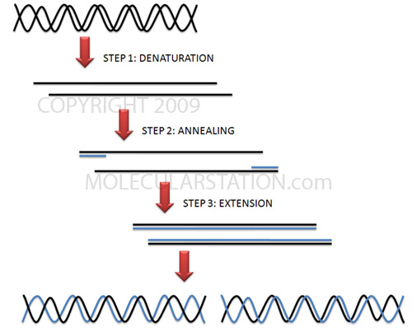
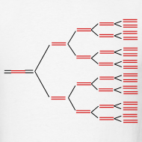
SOURCES OF IDEAS: SERENDIPITY
Serendipity
Driving through the mountains, Kary Mullis conceived of PCR in 1983; in 1993 won the Nobel Prize in chemistry
Source: http://image.spreadshirt.com/image-server/image/composition/17067237/view/1/producttypecolor/
1/type/png/width/190/height/190/pcr-diagram_design.png
GETTING STARTED

Slide 11
SOURCES OF IDEAS
Research results
Gradual advancement of on-going research
Screens for new pathways or biomarkers
Unexpected findings
Scientific publications / conferences
Significant new findings in the field
Discoveries from other fields applied to current field
Collaboration
Intramural
Extramural
Serendipity
Any time; anywhere
Source: http://undsci.berkeley.edu/index.php
GETTING STARTED

Slide 12
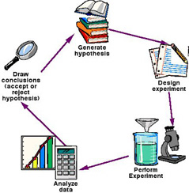




IDEAS and INTELLECTUAL PROPERTY
Apply for funding
Obtain Materials
Share
ideas
Adapted from: http://www.ucsd.tv/greymatters/images/GreyMatters_BasicScienceSM.jpg
GETTING STARTED

Slide 13
INTELLECTUAL PROPERTY CONSIDERATIONS
Event | File?
Research: preliminary data
Idea tested / untested | Maybe
Solely UCF / joint | Maybe
Scientific publications / conferences
Anticipated disclosure of results | Yes
Collaboration
Intramural | Maybe
Extramural | Yes
Proposal preparation
Private foundations | Yes
State agencies | Yes
Federal agencies | Maybe
GETTING STARTED

Slide 14
CONTACT INFORMATION
Office of Technology Transfer
12201 Research Parkway, Suite 201
Orlando, FL 32826
Director: Assistant Director:
Svetlana Shtrom, 407-823-5150 Andrea Adkins, 407-823-0138
svetlana.shtrom@ucf.edu andrea.adkins@ucf.edu
Engineering, Nano, Chemistry
Assistant Director: Senior Licensing Associate:
John Miner, 407-882-1136 Brion Berman, 407-882-0342
john.miner@ucf.edu brion.berman@ucf.edu
CREOL, FSEC, Chem. (Forensics) BSBS, Nano, COM, Chemistry
Technology Manager: Technology Manager:
Sandra Jaggernauth, 407-882-2448 Amanda Reno, 407-882-0350
dhankumari.jaggernauth@ucf.edu amanda.reno@ucf.edu
Physical Sciences Life Sciences
GETTING STARTED

Slide 15

QUESTIONS or COMMENTS?

Slide 16
Exploring Research Administration from Concept to Commercialization
PARTNERING AGREEMENTS
Terri Vallery

Slide 17
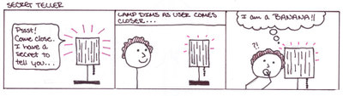
Non-disclosure agreement
PURPOSE
Protect information considered proprietary or confidential
Creates confidential relationship between two parties
a.k.a. Confidential Disclosure Agreement, NDA, CDA, PIA
GETTING STARTED

Slide 18
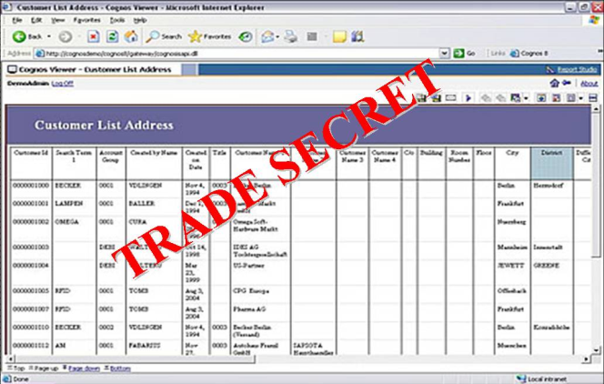
Non-disclosure agreement
WHEN TO USE IT
Two or more parties deciding whether to collaborate
Protected information must be shared
Designs
Ideas
Financial information
Trade secrets
Confidential information in copyrighted software
GETTING STARTED

Slide 19
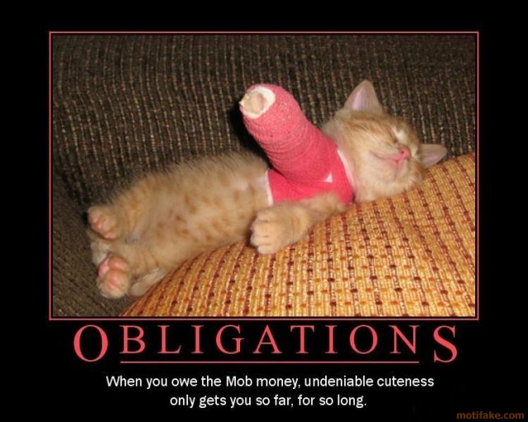
Non-disclosure agreement
WHAT IT INCLUDES
Definition of confidential information
Purpose of disclosure of information
Exclusions of confidential information
Obligations of receiving party
Time periods
Miscellaneous provisions
GETTING STARTED

Slide 20

Non-disclosure agreement
INTELLECTUAL
PROPERTY
PROVISIONS
GETTING STARTED

Slide 21


Teaming Agreement
PURPOSE
Temporary bridge between idea and final contract
Entities come together as a group to perform duties of a particular project
Defines each party’s responsibility in the bid process
PURPOSE
Temporary bridge between idea and final contract
Entities come together as a group to perform duties of a particular project
Defines each party’s responsibility in the bid process
GETTING STARTED

Slide 22

TEAMING AGREEMENT
WHEN TO USE IT
Prime contractor and a subcontractor agree to combine resources to bid on a project
Usually a major government project
GETTING STARTED

Slide 23

Teaming agreement
WHAT IT INCLUDES
Specifies party and project
Relationship of parties
Proposal preparation
Contract negotiation
Confidentiality
Protection of inventions
Miscellaneous provision
Appendix
GETTING STARTED

Slide 24

Teaming agreement
NOT
a contractual
commitment
of money
GETTING STARTED

Slide 25

Material transfer agreement
PURPOSE
Governs the transfer of tangible research materials when the recipient intends to use it for his/her
own research purposes
Defines the rights of the provider and
recipient with respect to the material
and derivatives
GETTING STARTED

Slide 26
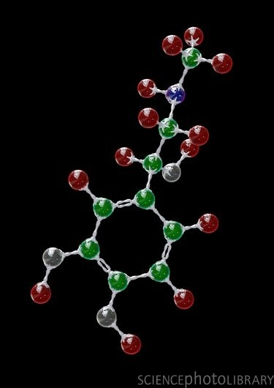
Material transfer agreement
WHEN TO USE IT
Transfer of biological materials
Reagents, cell lines, plasmids
Biological Agreement
Transfer of other materials
Chemical compounds
Some types of software
Non-Biological Agreement
GETTING STARTED

Slide 27
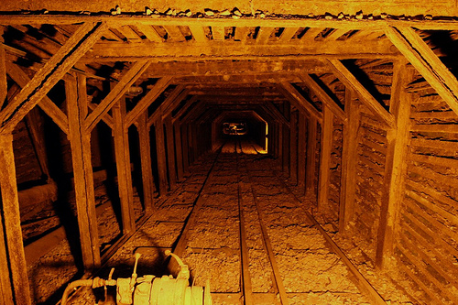
Material transfer agreement
WHAT IT INCLUDES
Definitions
Intended use
Ownership rights
Termination
Miscellaneous provisions
GETTING STARTED

Slide 28

Material transfer agreement
THREE TYPES OF MATERIAL TRANSFER SITUATIONS
Transfer between UCF and another academic institution
UBMTA
Transfer from industry to UCF
Usually with many restrictions that must be negotiated
Transfer from UCF to industry UCF template is used and negotiated
GETTING STARTED

Slide 29
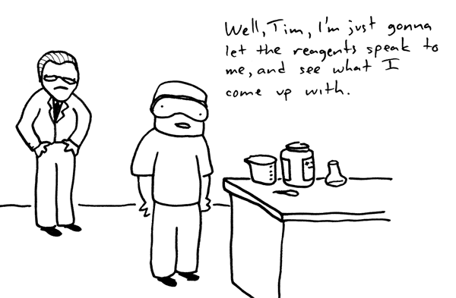
Material transfer agreement
TRANSFERS AND COMPLIANCE
IACUC – Live animals or custom antibodies
IRB – Human Tissue
Environmental Health & Safety – Hazardous materials and/or select agents
GETTING STARTED

Slide 30

Allocation of rights agreement
PURPOSE
Between a small business and partnering research institution to allocate:
Intellectual property rights
Rights to carry out follow-on research, development, or commercialization
GETTING STARTED

Slide 31



Allocation of rights agreement
WHEN TO USE IT
Required for all Small Business Technology Transfer (STTR) projects
Should be included with proposal
GETTING STARTED

Slide 32

Allocation of rights agreement
WHAT IT INCLUDES
Identifies background intellectual property the SBC can use non-exclusively for the research project
Royalty percentage of net sales when background intellectual property is used in the competitive commercialization of results
Project intellectual property rights
Guarantee that the Government shall maintain rights to background and project intellectual property
Miscellaneous provisions
GETTING STARTED

Slide 33
QUESTIONS or COMMENTS?

Slide 34
Exploring Research Administration from Concept to Commercialization
Strategies for Long Term Research Planning
Doug Backman

Slide 35

Strategies for Long Term Research Planning
Research Compliance
Finance & Administration
Export Control
Facility Security
Conflict of Interest
Research Misconduct
Investigations and Audit Mitigation
GETTING STARTED

Slide 36
Strategies for Long Term Research Planning
Research Compliance
Finance & Administration:
Facilities & Administration Rate (overhead Rate)
Project collections & AR
Time & Effort Reporting
Cost Transfers
Major Project Exemptions
Contract &G rant Close-out
Federal Reports (ARRA, Small Business, Property)
Training and Briefings
GETTING STARTED

Slide 37
Strategies for Long Term Research Planning
Research Compliance
Export Control:
Identifying & Monitoring Controlled Technology
Technology Control Plans
Deemed Export Reviews
Licensing Foreign Nationals
Property Control
Training and Briefings
GETTING STARTED

Slide 38
Strategies for Long Term Research Planning
Research Compliance
Facility Security:
Secret Clearance Level
Classified Contracts DD254
Personnel Clearances
Travel Authorizations
On-line Technology Communications
Training and Briefings
GETTING STARTED

Slide 39
Strategies for Long Term Research Planning
Research Compliance
Conflict of Interest:
Potential Financial Conflict Of Interest Reporting System
A&P, USPS, OPS & Graduate Student COI Reporting System
Reporting Outside Activity and Potential Financial Conflicts
Federal Concerns – Bias Factor
State of Florida Transaction Conflicts
Florida State Exemption
Monitoring Plans
GETTING STARTED

Slide 40
Strategies for Long Term Research Planning
Research Compliance
Research Misconduct:
Research Misconduct (plagiarism, Falsification & Fabrication)
Responsible Conduct in Research – NSF
Training (CITI Modules & Graduate Studies Seminars)
PTF Certification
iThenticate Plagiarism & duplication software
Research Misconduct Policy & ORI Assurance
Assessment, Inquiry & Investigations
Reporting to NIH and NSF
GETTING STARTED

Slide 41
Strategies for Long Term Research Planning
Research Compliance
Investigations and Audit Mitigation:
Federal Audit - OMB Circular A-133
Agency Directed Audits (Federal , State, Industry)
Internal Audits
OIG Investigations (Research Misconduct, False Claims, Un-allowable Expenses & Other)
Desk Audits
Pre-award Audits
Program Audits
GETTING STARTED

Slide 42
Strategies for Long Term Research Planning
Research Compliance
Questions & Comments ???
Doug Backman
407-882-1168
dbackman@ucf.edu
GETTING STARTED

Slide 43
QUESTIONS or COMMENTS?

Slide 44
Exploring Research Administration from Concept to Commercialization
UCF RESEARCH FOUNDATION
Betsy Gray

Slide 45
UCF RESEARCH FOUNDATION
501 (c)(3) Non-Profit
Eligible to receive tax deductible contributions.
Must be organized and operated exclusively for exempt purposes. For the RF, these are research and education.
Founded in 1991. In 2003, RF restructured for the acceptance of:
Private industry contract & grant projects
Contributions
Provides a flexible alternative to UCF and state processes.
Direct Support Organization of UCF
GETTING STARTED

Slide 46
UCF RF FUNDING
The UCF RF can accept:
Contracts & grants - typically documented with a formal
2-party agreement (primarily industry sponsors; no federal)
Donations – from individuals, foundations, or industry sponsors, with a tax receipt often provided by RF
Non-C&G sponsorships or awards – informal support for UCF activities or programs
Conference registration fees and support
License and royalty income – generated from UCF developed intellectual property
GETTING STARTED

Slide 47
BENEFITS OF USING THE UCF RF
Some funding agencies favor making awards to 501(c)(3)s.
RF can accept contractual language that UCF cannot.
The RF can accept the laws of another state or country, if necessary.
The RF can indemnify the other party, if necessary. UCF can not.
RF can pay for travel according to:
Receipts up to the limits set by RF
Meal allowance = $15, $20, $50 = $85/day
UCF travel guidelines
Meal allowance = $6, $11, $19 = $36/day
Agency travel guidelines as stated in award
GETTING STARTED

Slide 48
BENEFITS OF USING THE UCF RF
For fixed price industry awards, the administrative portion of F&A can be waived.
RF can pay for refreshments and other items which are difficult or impossible for UCF to pay, if funding agency terms & conditions allow.
RF e-mails financial summaries no later than the 10th of the month to PIs and other designated parties.
Project records for contracts, grants, and donations can be accessed through ORC’s ARGIS system.
Principal Investigators get credit for bringing in research funding for contracts, grants, and donations, just as they would if the project were run through UCF/ORC.
GETTING STARTED

Slide 49
UCF RF OPERATIONS
UCFRF is a separate entity from UCF.
We have our own:
Bank account
Accounting system
Purchasing system
Business manual
Federal employer identification number (EIN)
DUNS #
Florida tax exempt certificate
Functions are coordinated with the Office of Research & Commercialization to maximize the benefit to UCF’s research community.
GETTING STARTED

Slide 50
RESPONSIBILITIES
Responsibilities for C&G Activity Set-up through the RF
Sponsored Programs
Proposal review and appropriate F&A rate determination
Proposal submission
Negotiation of award
Obtaining signature of President, VP, or designee on award docs
No cost extensions and budget change requests
Pre-expenditure reviews
Research Foundation
Review and approval of expenditures
Financial reporting and invoicing
GETTING STARTED

Slide 51
UCF RF RATE SUMMARY
For C&G Activity
Charge full UCF F&A rate. The RF is included in UCF’s F&A Rate Proposal.
For fixed price industry awards, there is the option of waiving the administrative portion of F&A* if:
Sponsor pays in advance, prior to research being conducted.
Sponsor agrees that all intellectual property created by UCF shall remain the property of UCF.
Administrative requirements are minimal (tech. deliverables, financial reporting, etc.)
Sponsor has a positive contractual history with UCF or the RF, if a history exists.
*F&A is determined by deducting the administrative cap of 26% from the negotiated F&A rate:
45% - 26% = F&A rate of 19%
GETTING STARTED

Slide 52
AUDIT and REPORTING REQUIREMENTS
The RF accounting records are audited annually by an independent audit agency.
Copies of audits are provided to:
Finance & Accounting
University Audit
UCF Board of Trustees
State of Florida Board of Education
The RF files an annual 990 with the IRS and issues 1099s to independent contractors per IRS regulations.
The RF files an annual report with the State of Florida Division of Corporations and copies UCF’s General Counsel.
GETTING STARTED

Slide 53
ORGANIZATIONAL STRUCTURE
Board of Directors
MJ Soileau is President of the RF, UCF’s VP for Research
Tom O’Neal is Vice President of the RF, UCF’s Associate VP for Research
UCF’s President or his designee is required by Statute to be on UCFRF Board.
The Chair of the UCF Board of Trustees by Statute may appoint a member to the UCFRF Board.
Required to meet annually. Actually meet quarterly.
GETTING STARTED

Slide 54
UCF RF CONTACT INFORMATION
UCF Research Foundation, Inc.
12201 Research Parkway, Suite 501
Orlando, FL 32826-3246 +4 Mail Code: 0150
FAX: 407-882-2233
Chief Operating Officer: Chief Financial Officer:
Betsy Gray, 407-823-5278 Edward Jacobs, 407-882-1113
Betsy.gray@ucf.edu edward.jacobs@ucf.edu
Administrative Liaison: ORC Coordinator of Accounting:
Chris Dantes, 407-882-1124 Mieraf Tadesse, 407-823-0521
Chris.dantes@ucf.edu mieraf.tadesse@ucf.edu
Coordinator, Research & Program Services:
Hilary Hitchner, 407-882-0097
Hilary.hitchner@ucf.edu
GETTING STARTED

Slide 55
QUESTIONS or COMMENTS?

Slide 56
THANKS FOR JOINING US!
Please come to the next session:
PROPOSAL DEVELOPMENT & REVIEW
May 11, 2011
10:00 am to 12:00 pm
Sponsored Programs Administration Resource & Knowledge Series

